Slide 1

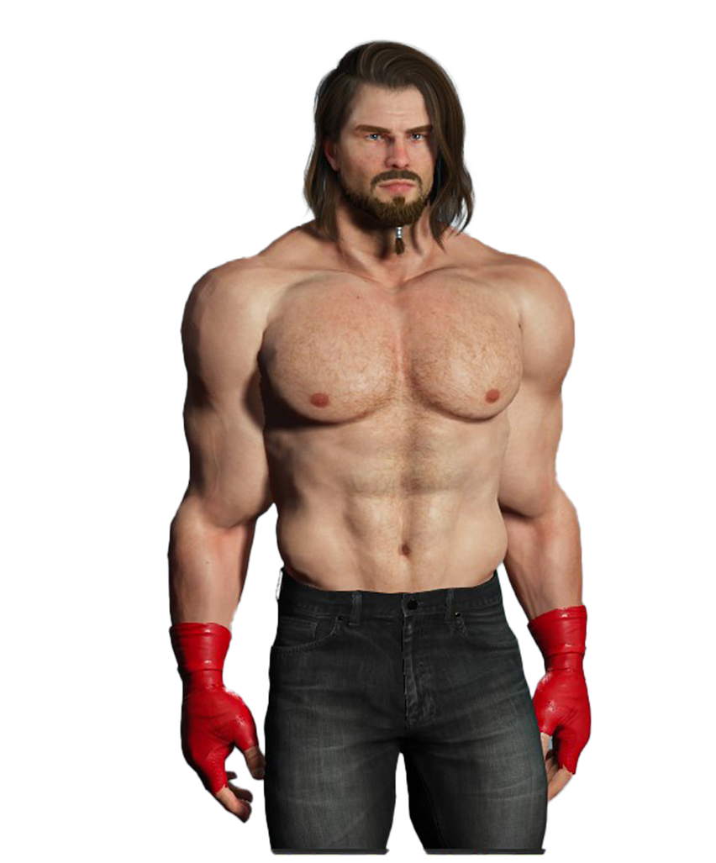



RAY
NERO
VS

Slide 2
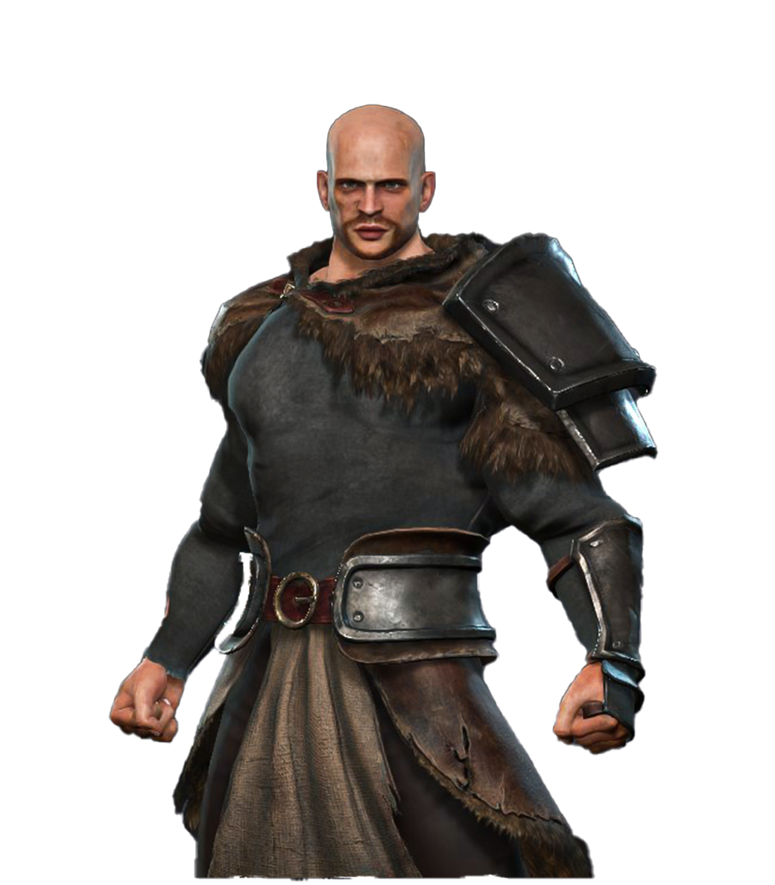
RAY
KEN
VS

Slide 3
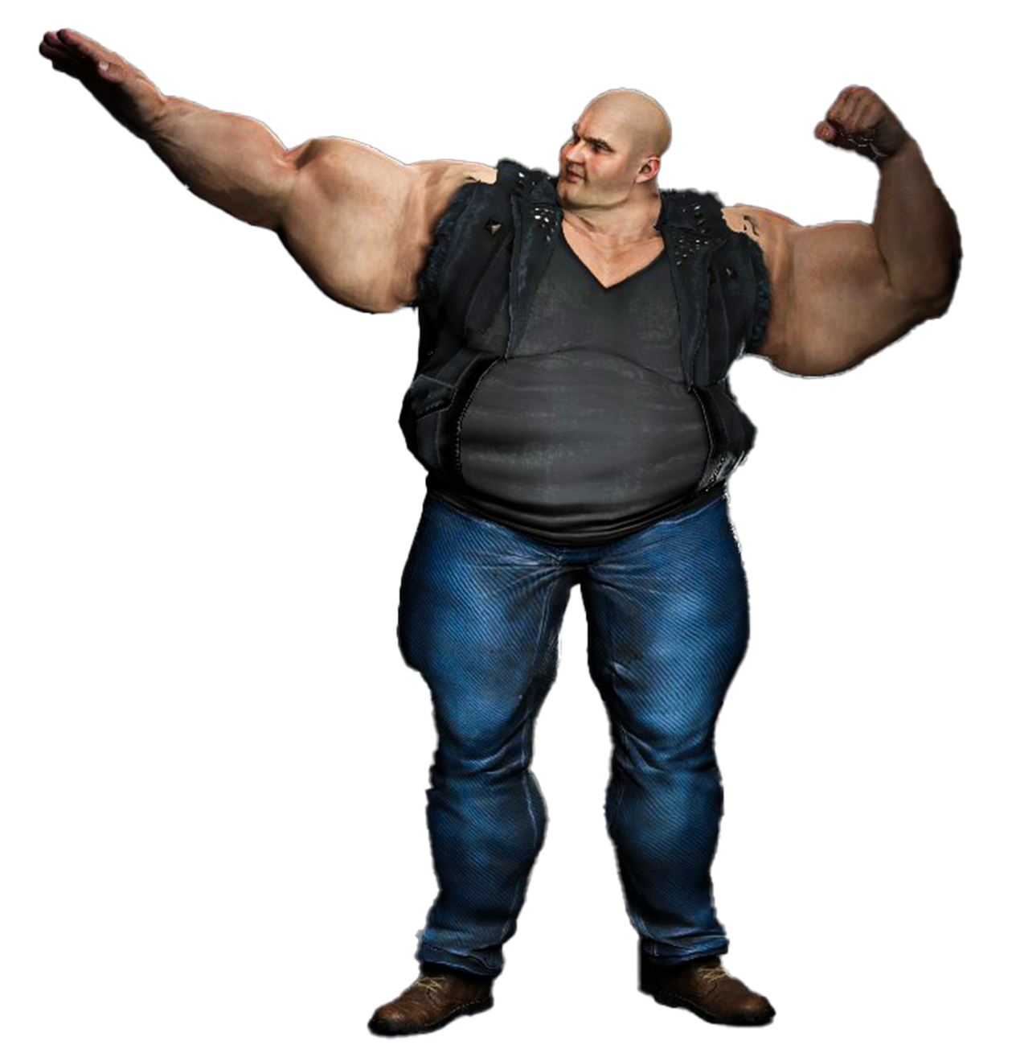
RAY
VERGIL
VS

Slide 4

RAY
V
VS

Slide 5
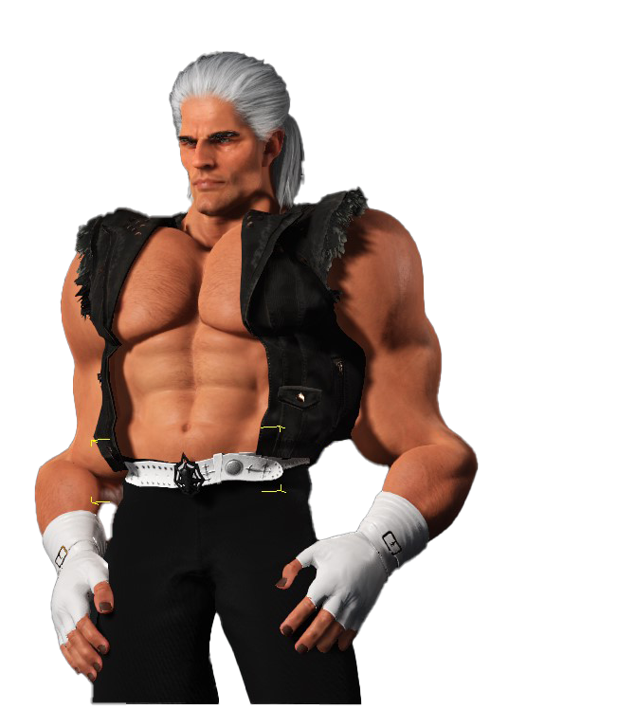
RAY
SHEEN
VS

Slide 6
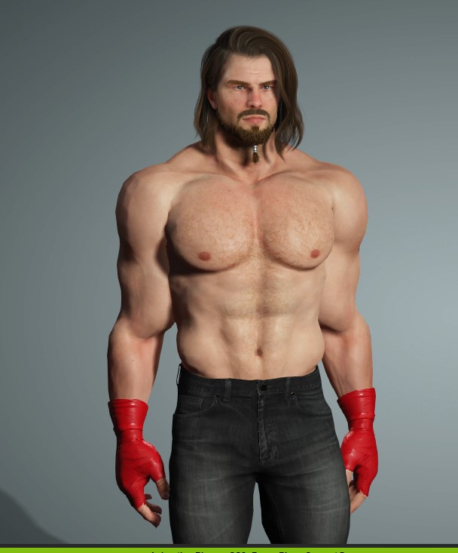

VS
RAY
SHEEN

Slide 7


VS
RAY
V

